Slide 1
World war II aircraft
1939 - 1945

Slide 2
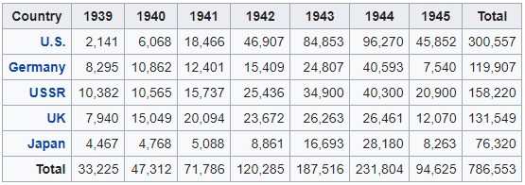
WWII aircraft production

Slide 3
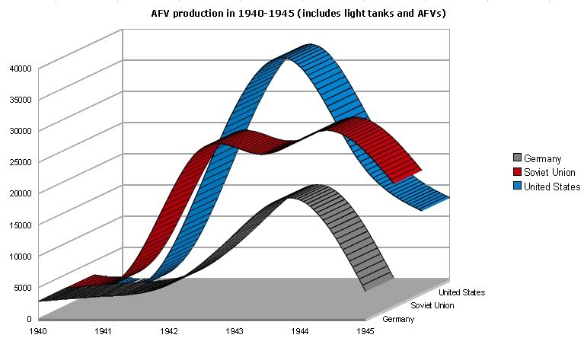

Slide 4
Operational aircraft
Fighter aircraft
Bomber and attack aircraft
Strategic and photo-reconnaissance aircraft
Seaplanes
Transport and utility aircraft
Trainers
Rotorcraft
Lighter than Air
Rockets and Drones

Slide 5
