Slide 1
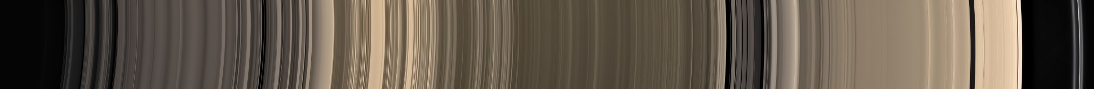
Moons of Saturn

Slide 2
62 confirmed moons
  53 with names
Range from 1.2M km to 1 km across
  Only 13 with diameters less than 50 km
24 are regular satellites
First 8 were discovered by direct observation
  Titan discovered by Christiaan Huygens in 1655
Long-exposure photographic plates made additional discoveries possible
Voyager and Cassini spacecraft imaged Saturn
Mostly named after mythological figures associated with the Roman god of agriculture and harvest (Saturn)

Slide 3
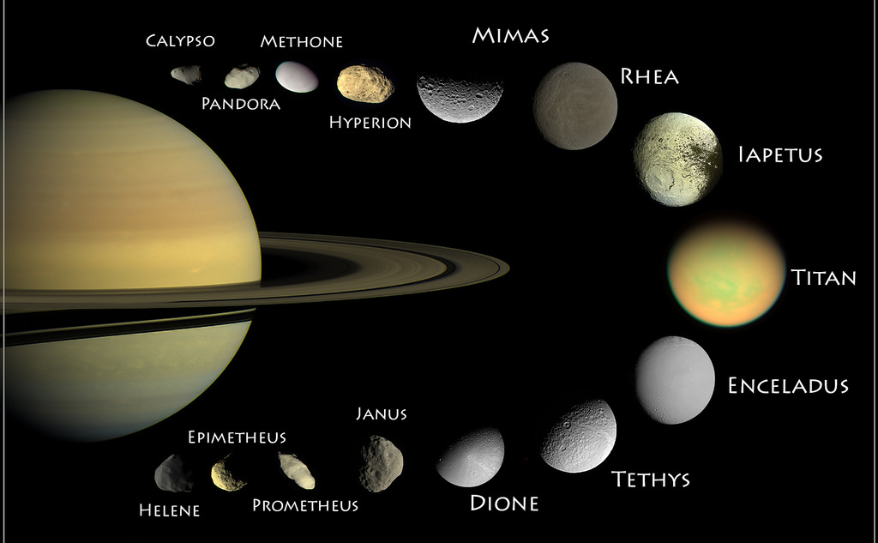
Major moons

Slide 4
Orbital groups
Although the boundaries may be somewhat vague, Saturn's moons can be divided into ten groups according to their orbital characteristics.
Many of them, such as Pan and Daphnis, orbit within Saturn's ring system and have orbital periods only slightly longer than the planet's rotation period.
The innermost moons and most regular satellites all have mean orbital inclinations ranging from less than a degree to about 1.5 degrees (except Iapetus, which has an inclination of 7.57 degrees) and small orbital eccentricities.
On the other hand, irregular satellites in the outermost regions of Saturn's moon system, in particular the Norse group, have orbital radii of millions of kilometers and orbital periods lasting several years.

Slide 5
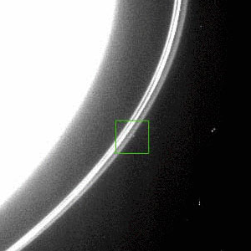

Unconfirmed moons

