Slide 1
Poetry of the ages

Slide 2
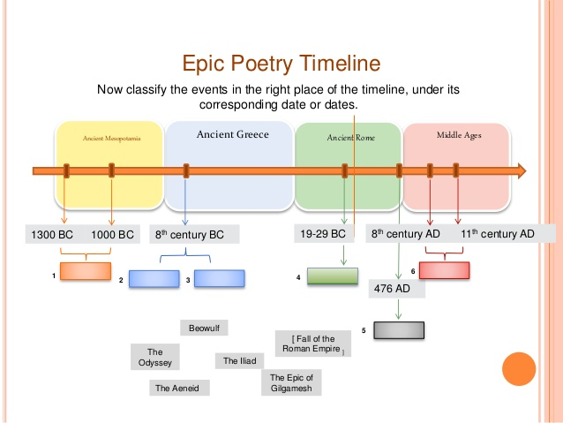

Slide 3
Forms
Sonnet
Shi
Villanelle
Limerick
Tanka
Haiku
Khlong
Ode
Ghazal

Slide 4
Famous Poems
There is another sky by Emily Dickinson
I, Too, Sing America by Langston Hughes
Phenomenal Woman by Maya Angelou
Where the Sidewalk Ends by Shel Silverstein
If You Forget Me by Pablo Neruda
I carry your heart with me by E. E. Cummings
The Road Not Taken by Robert Frost
A Dream Within A Dream by Edgar Allan Poe
A Girl by Ezra Pound
Messy Room by Shel Silverstein

Slide 5


