Slide 1
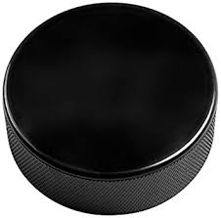
Ice hockey

Slide 2
What is ice hockey?
What is the equipment?
How is it played?

Slide 3
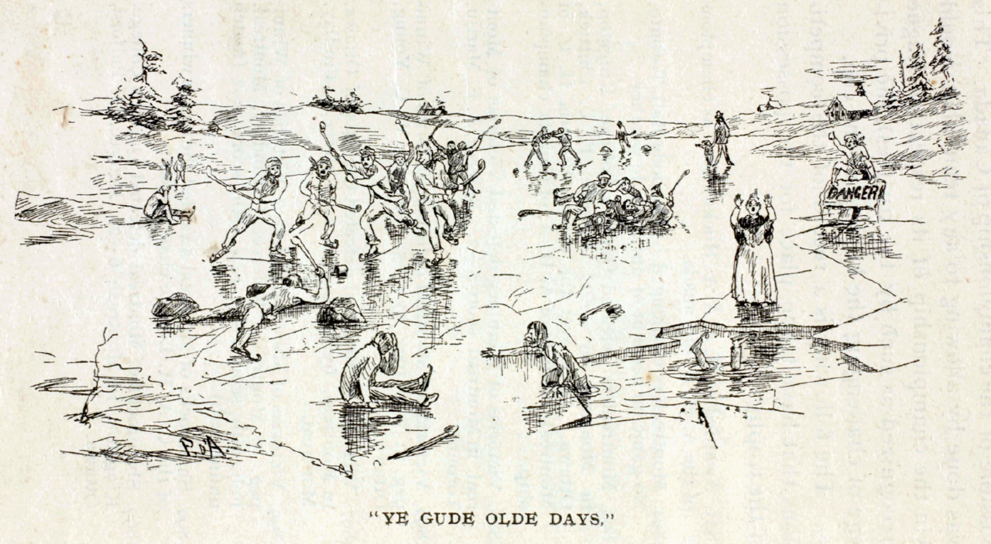
History

Slide 4
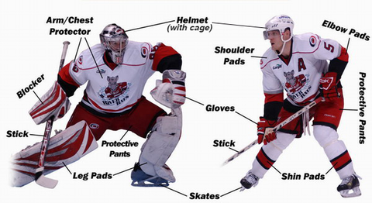
Equipment

Slide 5
