Slide 1
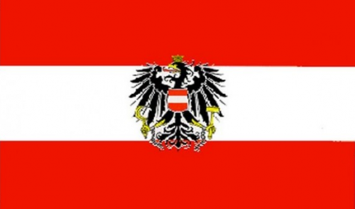
Austrian castles

Slide 2
Burg, burgruine, and schloss
“Castles”

Slide 3
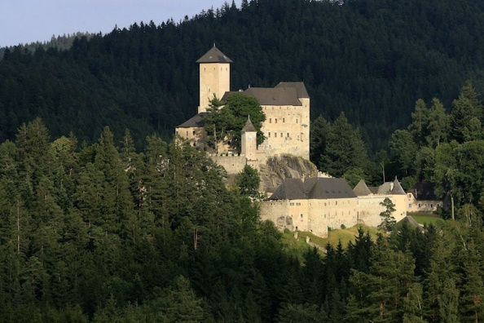
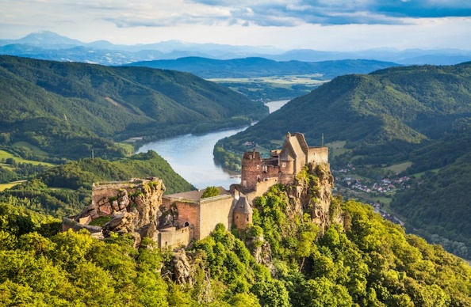
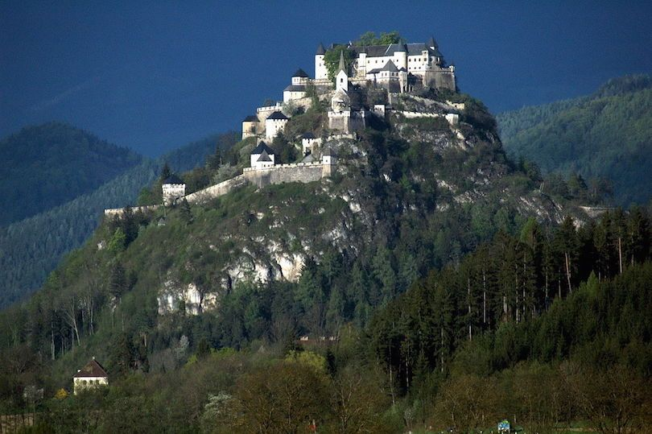
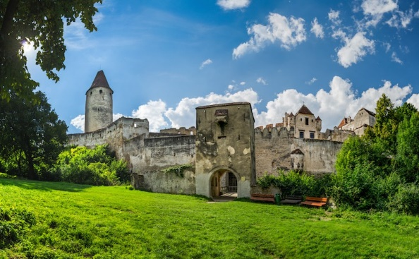
Burg Rappottenstein
Burgruine Aggstein
Burg Hochosterwitz
Burg Seebenstein

Slide 4
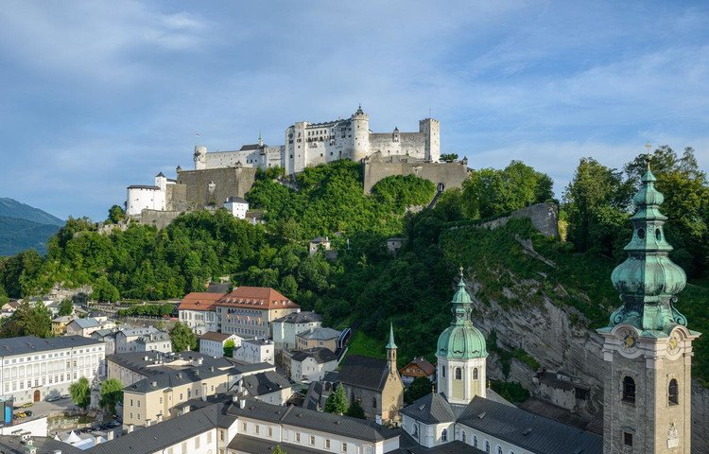
Hohensalzburg Fortress

Slide 5
Hohensalzburg Fortress
Hohensalzburg Fortress is enthroned on the Festungsberg, high above the rooftops of the Baroque historical district. The biggest fully preserved castle in Central Europe, this emblem of Salzburg draws millions of tourists to our “City of Mozart” every year.
The History of Hohensalzburg Fortress
  In the year 1077, archbishop Gebhard had the fortress built and thus changed the Salzburg skyline forever. In the years which followed, his successors drove ongoing development of the fortress architecture. The complex acquired the appearance we recognize today under archbishop Leonhard von Keutschach in 1500. The original purpose of the fortress was to protect the principality and the archbishops from hostile attacks. In all of these years, it has never been captured by foreign troops

